Slide 1

CUTTING STOCK 2D
REINFORCEMENT LEARNING
Group 3
AI17C
FPT University
Mar 24 2025

Slide 2
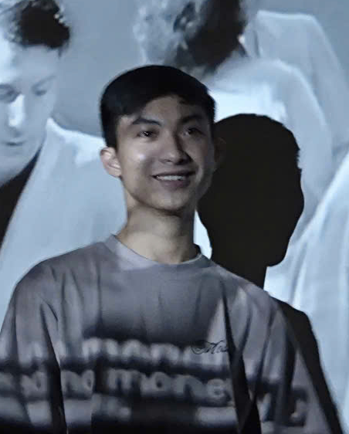
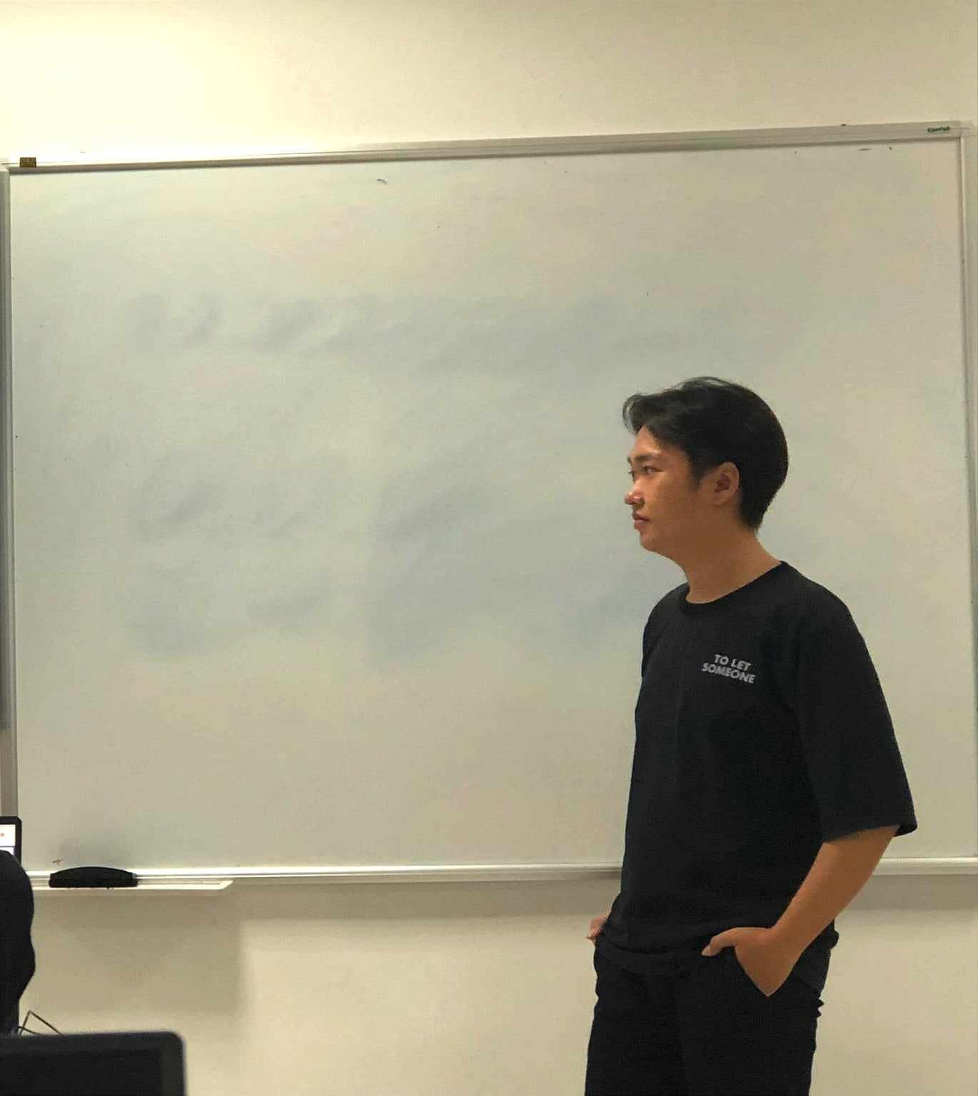



MEMBERS
Ha Khai Hoan
Nguyen Quoc Vuong
Nguyen Van Thu
Dang Phuc Bao Chau
Nguyen Van Sy Thinh

Slide 3

CONTENT
I
PROJECT OVERVIEW
II
IMPLEMENTATION
III
CONCLUSION

Slide 4
I. PROJECT OVERVIEW

Slide 5
PROJECT OVERVIEW
1
PROBLEM – CASE STUDY
2
CONSTRAINTS - INPUT & OUTPUT DATA
3
Input & Output Data

Slide 6
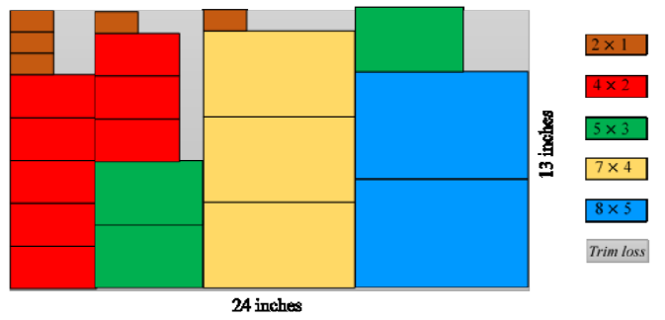



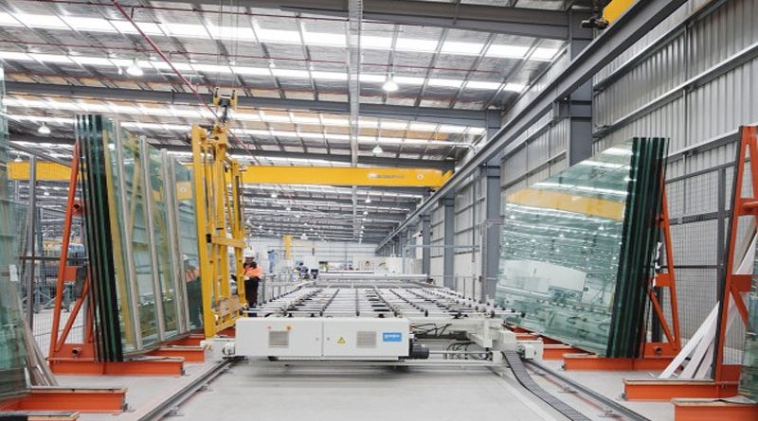
1 PROBLEM – CASE STUDY
Cutting Stock Problem (2D) is an important optimization problem in many industries such as metal processing, wood manufacturing, glass cutting, textiles...
"Case Study: Optimizing Glass Cutting in Manufacturing"
Cutting large glass panels into smaller custom sizes presents material waste challenges.
Factories struggle with inefficient cutting layouts, increasing costs and waste.
📌Objective: Cut large raw material sheets into small pieces as required while minimizing material waste.
♻️ Practical application: Reduce production costs, optimize resources, protect the environment.

Slide 7
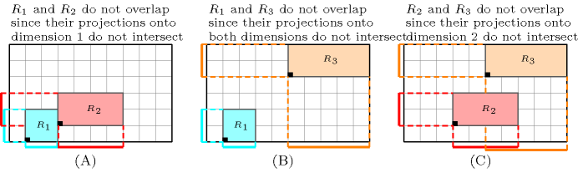
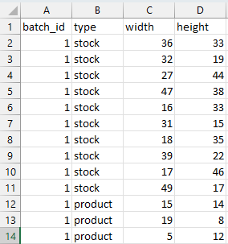
2 CONSTRAINTS - INPUT & OUTPUT DATA
#Constraints
Demand constraint: The number of cut products must meet the order demand.
Material usage constraint: The total area of ​​cut products must not exceed the size of the raw material.
No overlap constraint: The cut pieces must not overlap.
No large gap constraint: Minimize the gap between cut pieces.
Start from edge constraint: Cuts must start from the edge of the raw material sheet.
Stocks and products are numbered sequentially starting from 1 (index is 0 in the code) regardless of their similar size.
Start
(A): Two pieces R₁​ (blue) and R₂​ (red) are placed so that they do not overlap, with the dashed outline showing the space limit that each piece occupies.
Source: https://sofdem.github.io/gccat/gccat/Cdiffn.html
Pro 1
Pro 2
Pro 3
…
1x3
1x3
1x2
#Input & output data
We created a test data set of 10 batches. Each batch contains 10 stocks with different product sizes, but ensures that the number of stocks is enough to cut all the required products.
Stock size set
Algorithm
Area Used
Average Surplus
Stock Used
Execution Time
1 batch
Product size set

Slide 8
3 TASK
SY THINH
HEURISTIC
KHAI HOAN
Q - LEARNING
VAN THU
PPO
BAO CHAU
ALGORITHM
Master
QUOC VUONG
DATA - REPORT
Github: https://github.com/Hoanha2101/REL_mni_caption

Slide 9
II. IMPLEMENTATION

Slide 10
IMPLEMENTATION
1
HEURISTIC ALGORITHMS
2
PPO APPROACH TO TRAINING A RL AGENT
3
Q - LEARNING

Slide 11
1 HEURISTIC ALGORITHMS
1.1
FIRST-FIT ALGORITHM
1.2
BEST-FIT ALGORITHM
1.3
COMBINATION ALGORITHM
1.4
RESULTS

Slide 12
1.1 FIRST-FIT ALGORITHM
p1
p2
Function First_Fit_2DCSP:
Push one of each stock_type into the stock_list
For each stock in stock_list (sorted from largest to smallest area):
For each prod in product_list (sorted from largest to smallest area):
If prod can fit into stock:
Place prod into stock
Else:
Let stockType be the first stock_type that fits prod
Create a new stock of type stockType
Place prod into the new stock
If the textbf demand for prod is met:
Remove prod from the item list
p3
p3
p3
…
p3
…
STOCKS:
s1
s2
s3
s4
PRODUCT:
p1
p2
p3
p4
p5
Documentation: link

Slide 13



1.2 BEST-FIT ALGORITHM
Function Best_Fit_2DCSP:
Sort product_list from largest to smallest area
For each product in product_list:
best_stock ← None
min_remaining_area ← ∞
For each stock in stock_list:
If product can fit in stock:
remaining_area ← compute remaining area after placing product
If remaining_area < min_remaining_area:
min_remaining_area ← remaining_area
best_stock ← stock
If best_stock is not None:
Place product into best_stock
Else:
Create a new stock with dimensions (W_new, H_new)
Place product into the new stock
Add new stock to stock_list
Remove product from product_list once placed
Return stock_list
p1
s2
p1
p1
p1
s1
p1
p1
STOCKS:
PRODUCT:
p1
p2
p3
p4
p5
Documentation: link

Slide 14
1.3 COMBINATION ALGORITHM
step1
step2
Function Combination_2DCSP:
For each stock in stock_list (sorted from largest to smallest area):
For each prod in product_list (sorted from largest to smallest area):
For each (x, y) position in stock where prod can be placed:
If prod can be cut at (x, y):
Compute S_ij as the area of the smallest rectangle containing the cut area
Find (x0, y0) where S_ij is minimized
Cut prod from stock at position (x0, y0)
For each stock in cut_stock_list (sorted from smallest to largest area):
For each stock_j in uncut_stock_list (sorted from smallest to largest area):
If cut area of stock_i is smaller than stock_j:
Move cut set from stock_i to stock_j
p1
p2
p3
p1
p2
p3
p4
p5
p4
p5
p5
area 2
area 1
area 1 > area 2
s2
s1
s3
s4
s5
STOCKS:
s2
s3
s4
PRODUCT:
p2
p3
p1
p4
p5

Slide 15
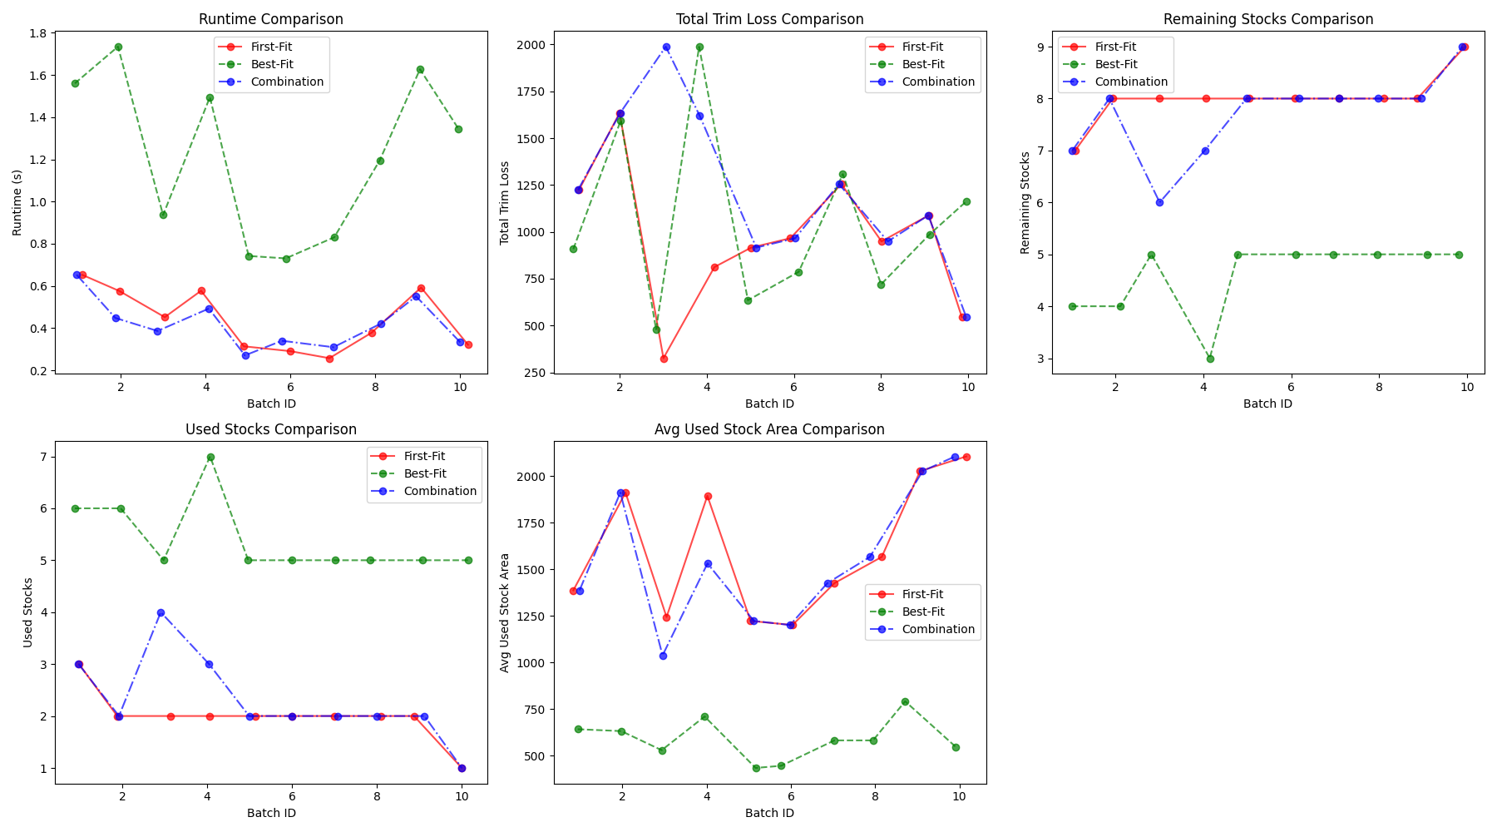
1.4 RESULTS
Best-Fit is the most efficient in minimizing trim loss but comes at the cost of significantly higher runtime and more stock usage.
First-Fit and Combination are computationally efficient but may lead to slightly higher trim loss.
Combination performs similarly to First-Fit, with some variations in total trim loss and used stock area.

Slide 16
2 PPO APPROACH TO TRAINING A RL AGENT
2.1
OVERVIEW ABOUT PROXIMAL POLICY OPTIMIZATION
2.2
APPLYING PPO TO CUTTING STOCK PROBLEM
2.3
RESULTS

Slide 17
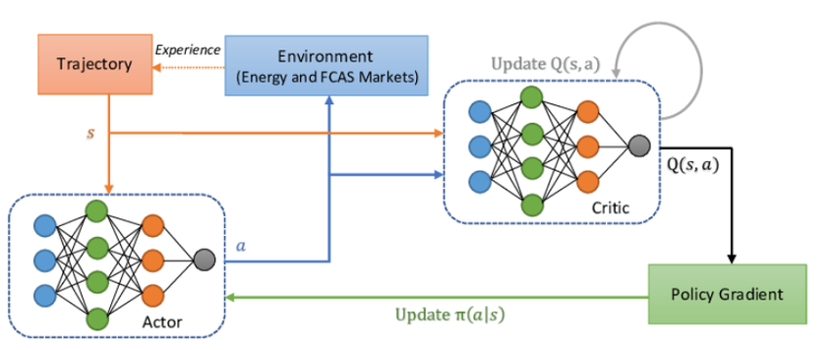
2.1 OVERVIEW ABOUT PROXIMAL POLICY OPTIMIZATION
Proximal Policy Optimization (PPO) is a reinforcement learning (RL) algorithm belonging to the policy-based methods group. It was proposed by OpenAI in 2017 to address the drawbacks of previous policy optimization algorithms such as Trust Region Policy Optimization (TRPO) and Actor-Critic.
PPO is particularly effective in optimizing policies by ensuring that policy updates are not excessively large in each step. This makes it more stable compared to traditional policy gradient methods.
Proximal Policy Optimization (PPO) architecture
Link

Slide 18
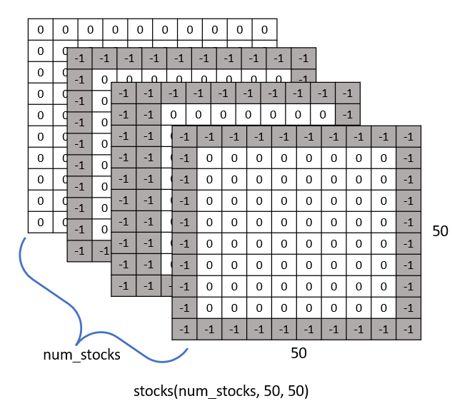
2.2 APPLYING PPO TO CUTTING STOCK PROBLEM
2.2.1. Setting up elements in PPO:
a. Stocks:
Creating the initial matrix: For each glass sheet, an initial matrix of size (width, height) is created with all values set to 0, representing empty cells ready for cutting.
Padding to a fixed size: To standardize the input size for the model, all Stock matrices are padded to a fixed size of (50, 50) using the pad_stocks function. The cells outside the original dimensions of the glass sheet are assigned a value of -1 to denote the padded area, while the cells within retain the value 0.
This results in a 3D tensor with dimensions (num_stocks, 50, 50), where num_stocks is the number of glass sheets in the dataset.

Slide 19
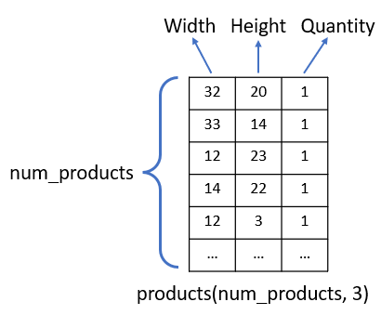
2.2 APPLYING PPO TO CUTTING STOCK PROBLEM
2.2.1. Setting up elements in PPO:
b. Products:
Preparing the information matrix: Each product is represented as a vector [width, height, quantity].
Dynamic updating: During the simulation, the quantity value in the Product matrix is decremented by 1 each time a product is successfully cut, allowing for tracking the remaining number of pieces.
This results in a 2D matrix with size (num_products, 3).

Slide 20
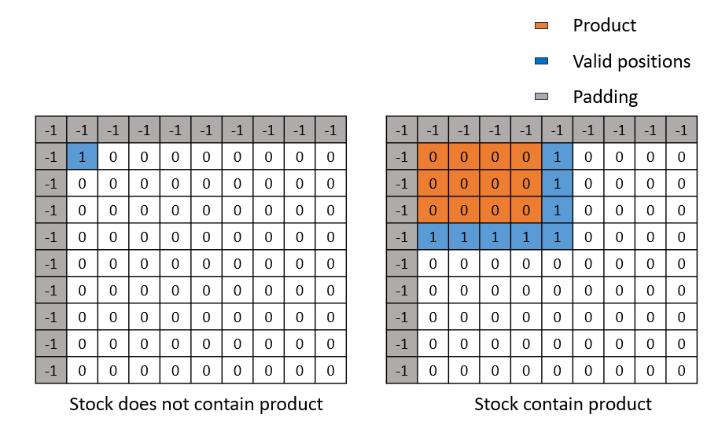
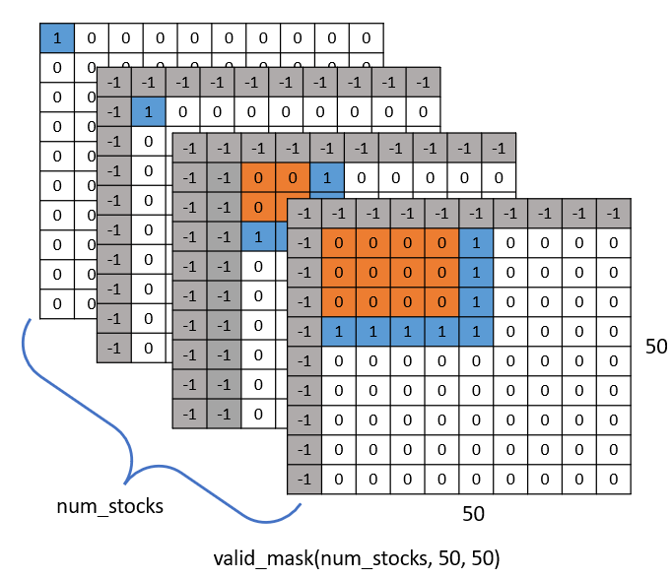
2.2 APPLYING PPO TO CUTTING STOCK PROBLEM
2.2.1. Setting up elements in PPO:
c. Valid_mask:
The Valid_Mask data is a binary matrix that designates valid positions on each glass sheet where cutting actions can be performed.
Initial Setup: The Valid_Mask matrix is initialized with dimensions (num_stocks, 50, 50) and all values set to 0. For each glass sheet (stock), if no product has been cut (i.e., all values in the stock are 0 or -1), only the position (0, 0) is set to 1 to indicate a default valid position. If products have been cut into the sheet, valid positions are positions around the products.
Dynamic Updating: After each successful cutting action, the update_valid_mask function is called to recalculate the Valid_Mask for the corresponding glass sheet. This process ensures that the Valid_Mask accurately reflects the remaining empty positions after each step, based on the current state of the stock.

Slide 21
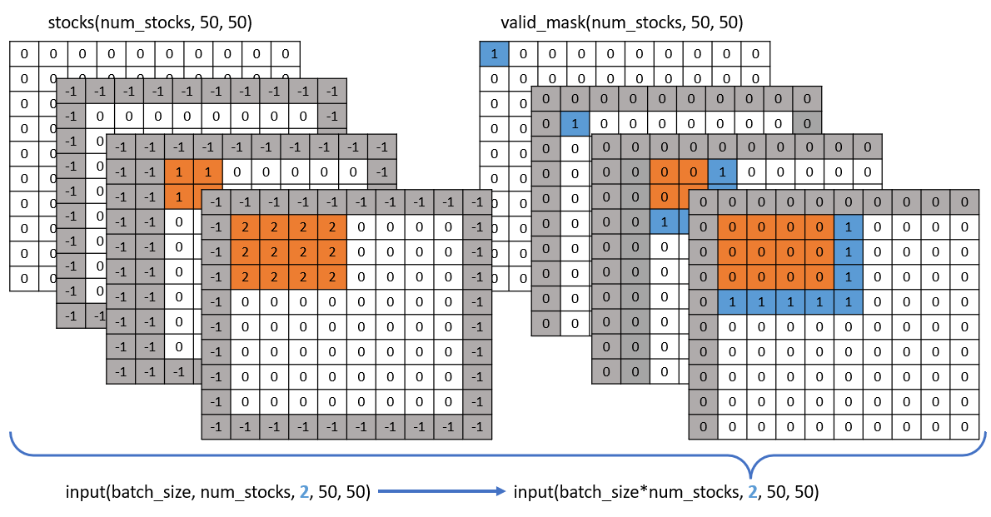
2.2 APPLYING PPO TO CUTTING STOCK PROBLEM
2.2.1. Setting up elements in PPO:
d. Convolutional Neuron Network (CNN):
The CNN is designed to extract features from 2D input data, specifically the Stock and Valid_Mask matrices. Its architecture includes convolutional layers to recognize spatial patterns in the glass sheets and valid positions. Specifically:
Input: A 4D tensor of shape (batch_size*num_stocks, 2, 50, 50), where the first channel contains the Stock information (values ranging from -1 to num_products) and the second channel contains the Valid_Mask (binary values 0 or 1). The operation of combining batch_size and num_stocks merges all the glass sheets in the samples into a single dimension, ensuring the input is suitable for the CNN architecture, where each sample consists of two spatial information channels processed concurrently.

Slide 22
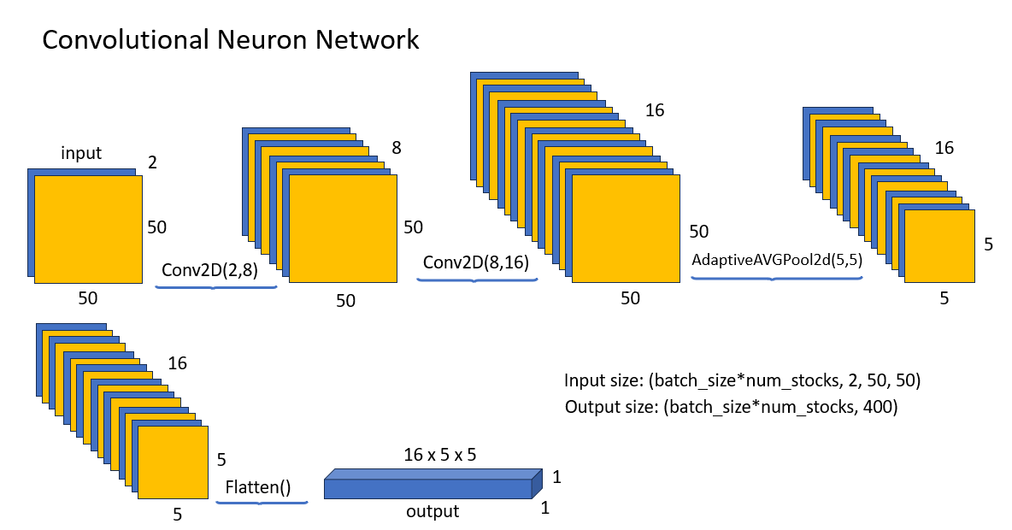
2.2 APPLYING PPO TO CUTTING STOCK PROBLEM
2.2.1. Setting up elements in PPO:
d. Convolutional Neuron Network (CNN):
Structure: The CNN consists of one or more convolutional layers (typically using a 3x3 kernel, stride of 1, and appropriate padding) to reduce the spatial dimensions and extract features. This is followed by a pooling layer (often max pooling) or a flattening layer to convert the output into a one-dimensional feature vector.
Output: A feature vector of size (batch_size, feature_dim), where feature_dim is the number of extracted features (designed flexibly, e.g., 64 or 128). This vector represents a summary of the state of all glass sheets in the batch.

Slide 23
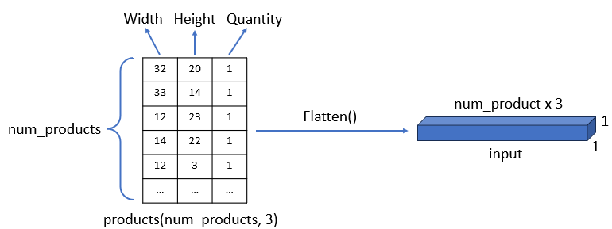
2.2 APPLYING PPO TO CUTTING STOCK PROBLEM
2.2.1. Setting up elements in PPO:
e. Multilayer Perceptron (MLP):
The MLP is used to process the Product data, which is a 2D matrix containing information about the width, height, and remaining quantity of the products. Its architecture includes fully connected layers to map the product information into meaningful features. Specifically:
Input: A 2D tensor of shape (batch_size, num_products * 3), which is a flattened version of the matrix (num_products, 3).

Slide 24
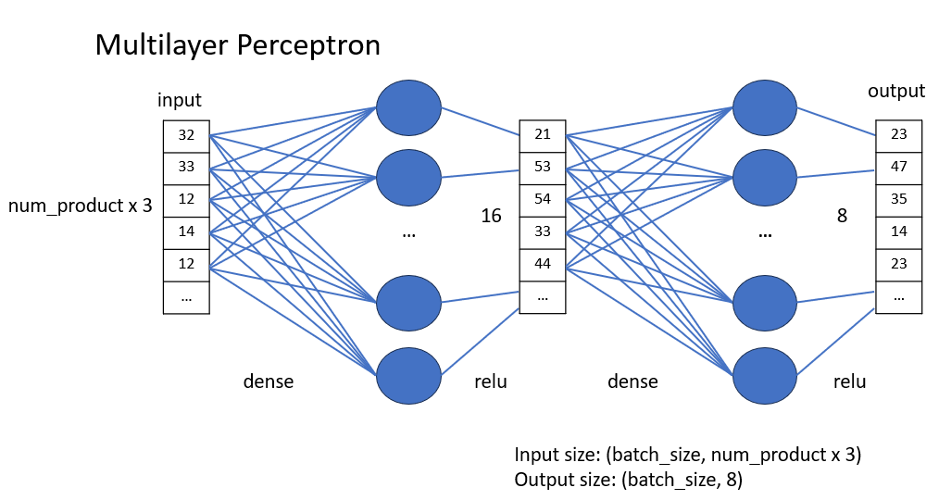
2.2 APPLYING PPO TO CUTTING STOCK PROBLEM
2.2.1. Setting up elements in PPO:
e. Multilayer Perceptron (MLP):
Structure: The MLP consists of one or more hidden layers, typically using the ReLU activation function to introduce non-linearity. The number of neurons in each hidden layer is designed flexibly (e.g., 64 or 128), and the output is compressed into a feature vector.
Output: A feature vector of size (batch_size, hidden_dim) (for example, 8), representing a summary of the remaining product information.

Slide 25
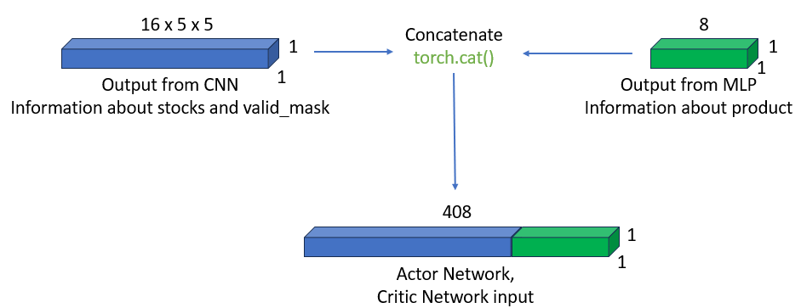
2.2 APPLYING PPO TO CUTTING STOCK PROBLEM
2.2.1. Setting up elements in PPO:
f. Actor Network:
The Actor network is a component of the PPO model, responsible for learning the policy to select the optimal action based on the current state. This architecture combines the outputs from the CNN and MLP to generate a probability distribution over actions. Specifically:
Input: A feature vector obtained by concatenating the outputs of the CNN (related to Stock and Valid_Mask) and the MLP (related to Product), forming a combined vector of size (batch_size, feature_dim + hidden_dim).

Slide 26
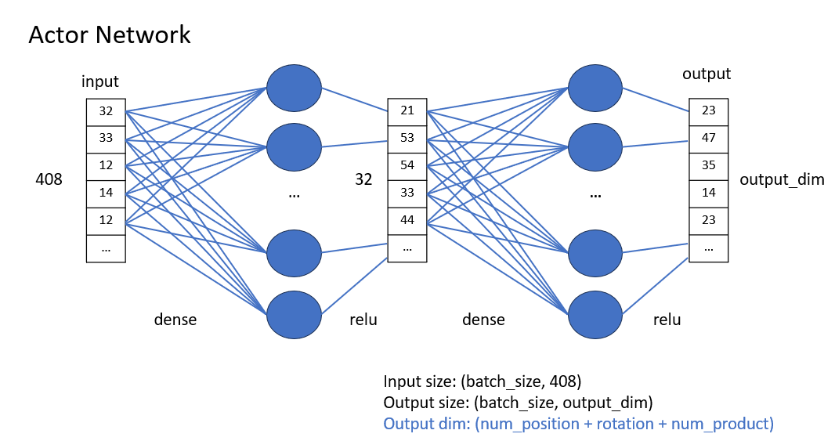
2.2 APPLYING PPO TO CUTTING STOCK PROBLEM
2.2.1. Setting up elements in PPO:
f. Actor Network:
Structure: The Actor network includes one or more hidden layers (typically using ReLU) to process the combined vector, and then branches out into separate outputs:
A Categorical distribution for the position index (pos_logits) with a shape of (batch_size, num_stocks * 50 * 50), representing all possible positions on the glass sheets.
A Categorical distribution for the rotation decision (rot_logits) with a shape of (batch_size, 2).
A Categorical distribution for the product index (prod_logits) with a shape of (batch_size, num_products).
Output: A sampled action drawn from these distributions, including (x, y, rotate, product_idx), along with the distributions used to compute the loss during training.

Slide 27
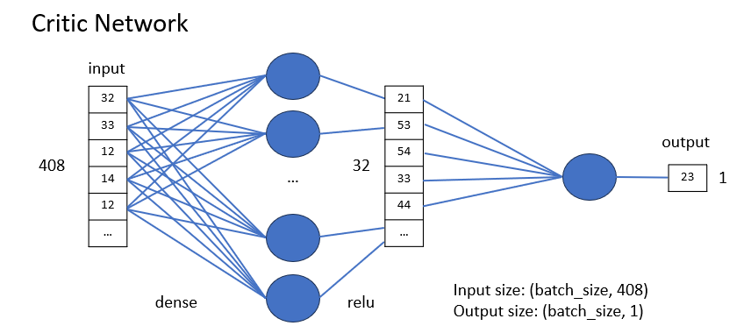
2.2 APPLYING PPO TO CUTTING STOCK PROBLEM
2.2.1. Setting up elements in PPO:
f. Critic Network:
The Critic network is the other component of the PPO model, designed to estimate the state value, which helps evaluate the quality of the policy. This architecture uses the same input as the Actor network to predict the expected reward. Specifically:
Input: The combined feature vector from the CNN and MLP, identical to that used by the Actor network, with a shape of (batch_size, feature_dim + hidden_dim).
Structure: The Critic network consists of one or more hidden layers (typically using ReLU), ending with a single output layer with a linear activation function to predict the state value.
Output: A tensor of shape (batch_size, 1), representing the estimated value of the current state.

Slide 28
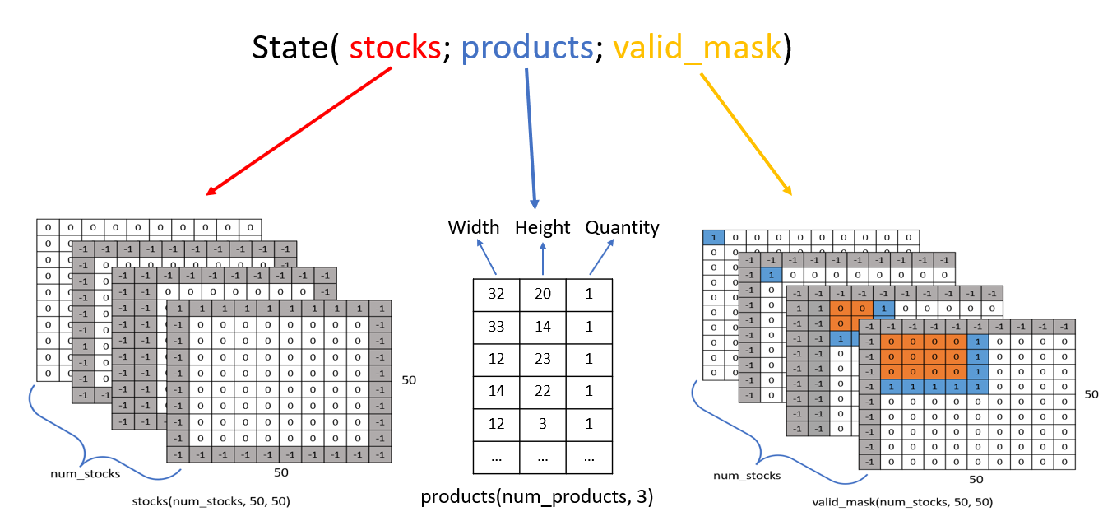
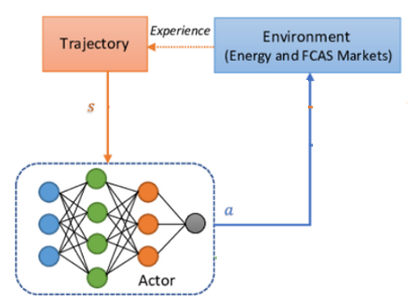
2.2 APPLYING PPO TO CUTTING STOCK PROBLEM
2.2.2. Workflow of Training process:
a. State:
The state will consist of three channels for storing information: stocks, products, and valid_mask.
Each time a change occurs, all three channels will be updated to produce a new state.

Slide 29
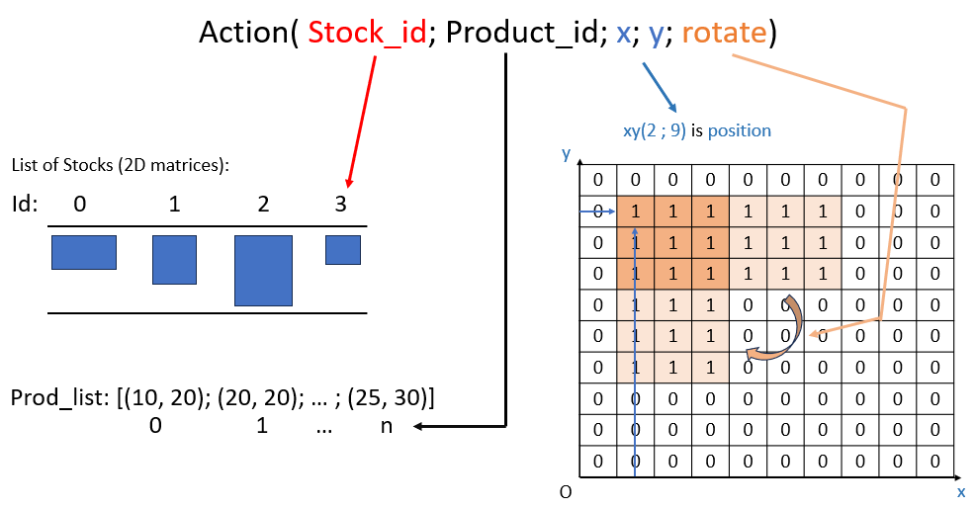
2.2 APPLYING PPO TO CUTTING STOCK PROBLEM
2.2.2. Workflow of Training process:
b. Action:
Create a discrete distribution on the output of the actor network.
The discrete distribution will have a dimension of (num_product*50*50 + 2 + num_product).
From this discrete distribution, we can sample an action (Stock_idx, x, y, rotation, product_idx).

Slide 30
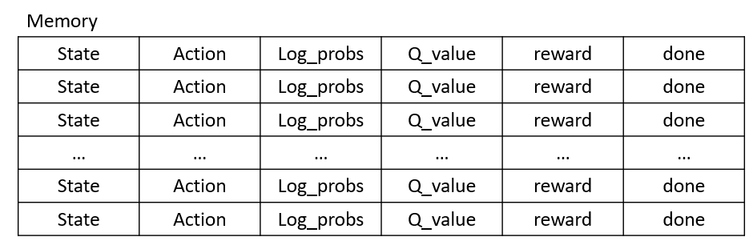
2.2 APPLYING PPO TO CUTTING STOCK PROBLEM
2.2.2. Workflow of Training process:
c. Experience - memory:
Memory is where the agent's experiences are stored, supporting the policy update process.
Each experience will be stored as (State, action, log_probs, Q_value, reward, done).
Experience

Slide 31
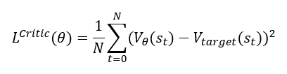
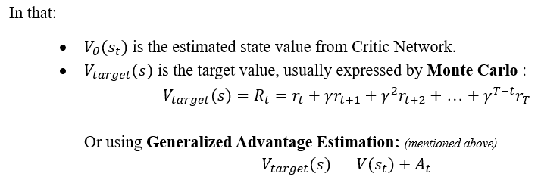
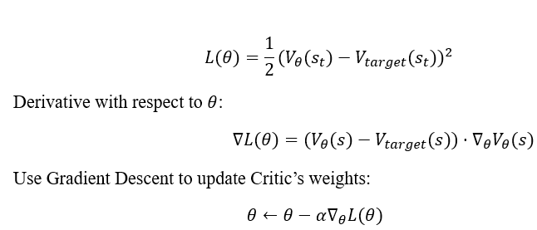
2.2 APPLYING PPO TO CUTTING STOCK PROBLEM
2.2.2. Workflow of Training process:
d. Update Q(s,a):
Use Mean Square Error to train Critic network.

Slide 32
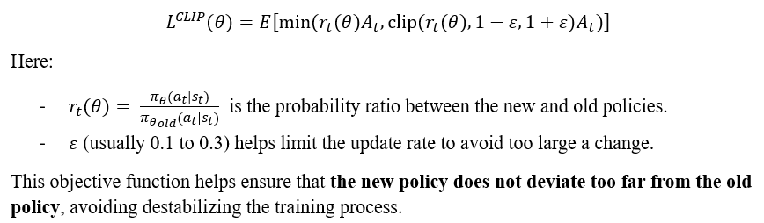
2.2 APPLYING PPO TO CUTTING STOCK PROBLEM
2.2.2. Workflow of Training process:
e. Update Policy:
Use Clipped Surrogate Loss to optimize Actor.
Derivative with respect to $θ$:
Use Gradient Descent to update Actor’s weights:
$$θ←θ−α∇_{θ}L\left(θ\right)$$

Slide 33
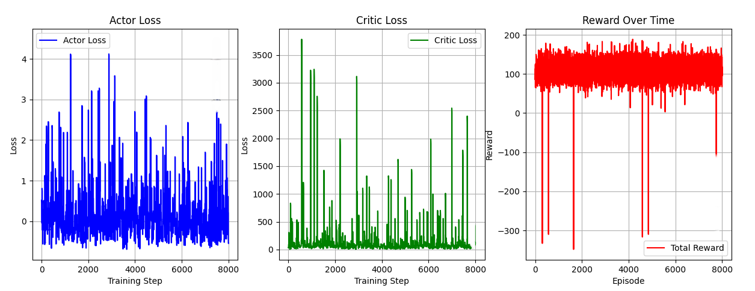
2.3 RESULT
2.3.1. Training:

Slide 34
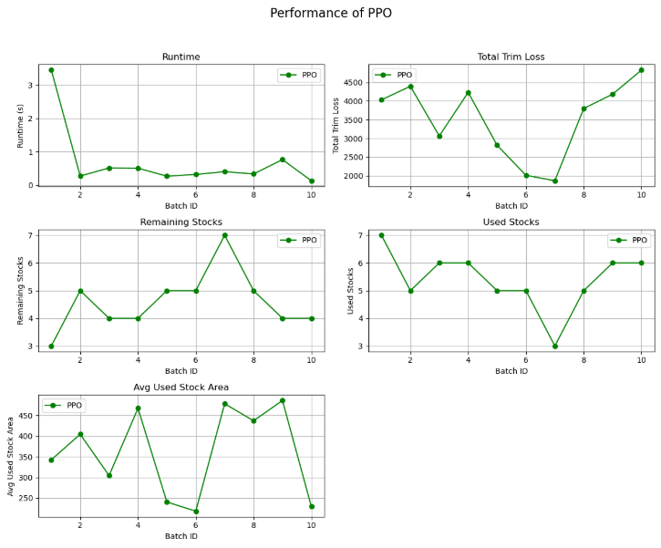
2.3 RESULT
2.3.2. Efficiency:

Slide 35
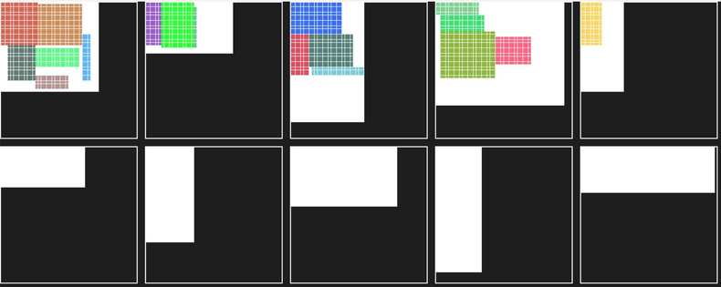
2.3 RESULT
2.3.3. Result:

Slide 36
3 Q - LEARNING
3.1
Overview About Q-Learning
3.2
Architecture of Q-Learning Agent
3.3
State Representation
3.4
Epsilon-Greedy Policy
3.5
Action Conversion – Update Q-Table
3.6
Result

Slide 37
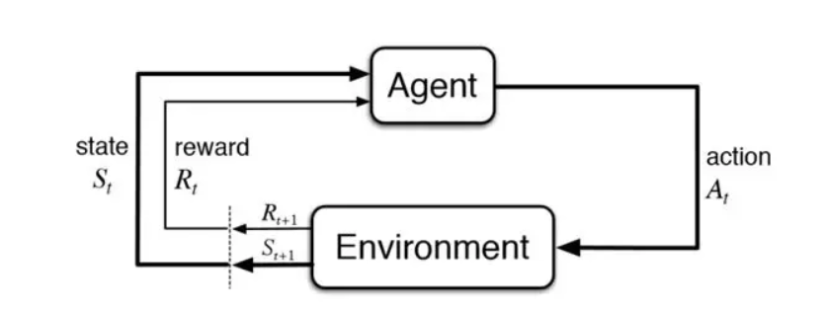
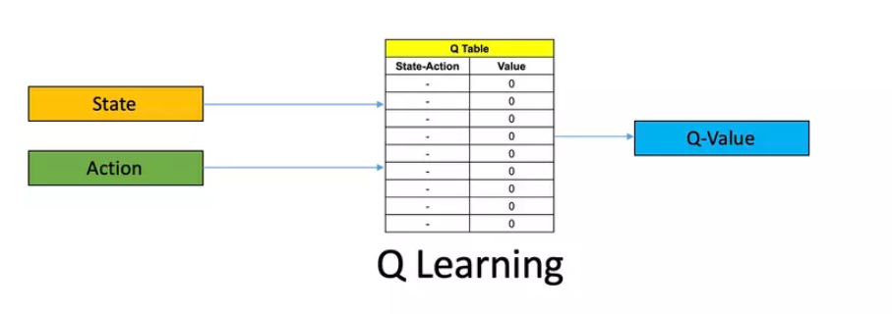
3.1 Overview About Q-Learning
In RL, the machine learns how to perform a task by interacting with the environment through actions and making optimal choices based on the rewards of each action. The way this algorithm is built is quite similar to the way we humans learn, through trial and error.
Below is a diagram that describes how RL works
The Q-Learning model is similar to the process mentioned above. However, instead of basing decisions on the value of "states" to decide on actions, Q-Learning focuses more on evaluating the quality of an action Q(s, a).

Slide 38
3.2 Architecture of Q-Learning Agent
The interaction loop works as follows:
The environment provides an observation that contains the current status (e.g., available stocks and remaining products)
This observation is converted into a state using a state representation function.
The agent then selects an action based on its current policy (implemented via the ε-greedy strategy).
The chosen action is converted into a concrete command that the environment can execute.
The environment executes the action, and returns a reward along with the next observation.
The agent uses this reward and the new state to update its Q-table using the Bellman Equation.
Overview and Interaction Loop:
The Q-Learning Agent is designed to learn an optimal decision-making strategy by interacting with the environment.
It does not require a model of the environment—instead, it learns from experience by updating a Q-table.
Enviroment
(Stock & Prodducts)
Observation
get_state()
State = empty_space * 1000 + remaining_products
Q-Learning Agent (Q-Table Lookup & ε-Greedy Policy)
Selected Action Index
update()
(Bellman Equation-Based Q-Table Update)
Environment(Executes Action, returns Reward & Next State)
get_env_action()
(Decodes action index into stock, product, and position)

Slide 39
3.3 State Representation
Purpose of State Representation:
Objective:
The primary goal is to transform the raw information provided by the environment (i.e., details about stocks and products) into a single discrete state index. This index is then used to access and update the Q-table.
Why It’s Needed:
The environment’s observation can be complex and multi-dimensional. By encoding it into a single state number, we can simplify the learning problem and make it feasible to store and update Q-values for each state-action pair in a table.
Enviroment Obs
- Stocks (free/used)
- Products (quantities)
Process
(get_state)
get_state()
State = empty_space * 1000 + remaining_products
Discrete State
Index (s)

Slide 40
3.4 Epsilon-Greedy Policy
Current State (S)
Q-Table Lookup
Random action
(Explore new possibility)
if rand < ε
ε-Greedy Decision Node
(Generate random number)
if rand > ε
Greedy Action
(Select argmax Q(s,a))
Selected Action (a)

Slide 41
3.5 Action Conversion – Update Q-Table
I. Action Conversion
How it works:
Mapping to Product::
The action index is first used to select a product. This is done with the expression:
Product index=action%number_of_products
This modulo operation ensures that the selected product index is within the valid range of available products
Mapping to Stocks:
Next, the action index is used to select the stock. This is calculated as:
stock index=(action//number_of_products)%number_of_stocks
Here, the floor division (//) reduces the action index by effectively “removing” the product choice, and then the modulo ensures the stock index is valid.
Finding a Valid Position:
Once the product (with its size, e.g. (prod_w, prod_h)) and stock (with its available area) are chosen, the code iterates over possible positions in the selected stock to find a place where the product can be cut without overlapping existing cuts.
If a valid position (x, y) is found—where the area in the stock is completely available (cells are marked as free)—then the action conversion returns an environment action
Purpose:
The agent’s policy selects an action as a single integer (an action index). However, the environment requires a detailed action that specifies:
Which stock to use (stock_idx)
What product size to cut (size, typically a tuple (width, height))
At which position on the stock to perform the cut (position, a tuple (x, y))

Slide 42
3.5 Action Conversion – Update Q-Table
I. Action Conversion
Action Index (a)
Calculate Product Index
prod_index = a % num_prods
Calculate Stock Index:
stock_index = (a // num_prods) % num_stocks
Find a Valid Position on Selected Stock
(Iterate possible (x,y) positions until a free area is found that fits product size)
Final Environment Action:
{ “stock_idx": stock_index,
“size”: (prod_w, prod_h),
“position”: (x,y) }

Slide 43
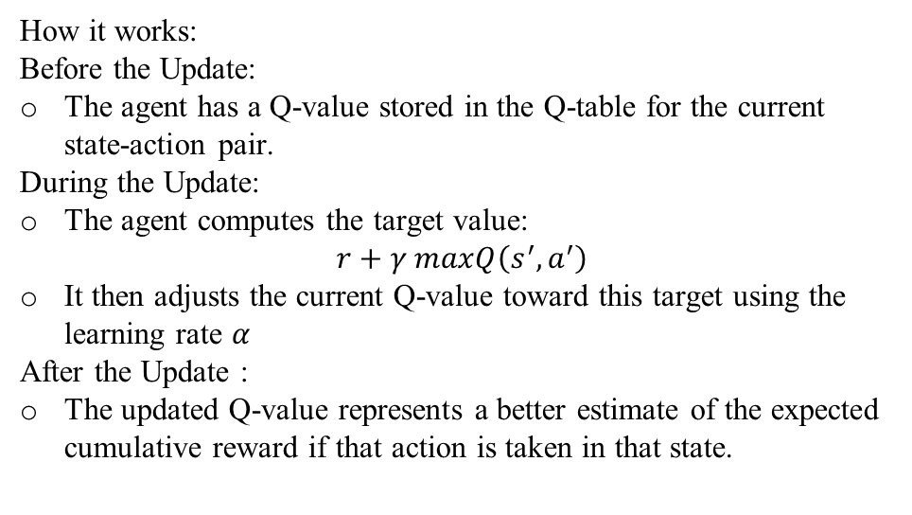
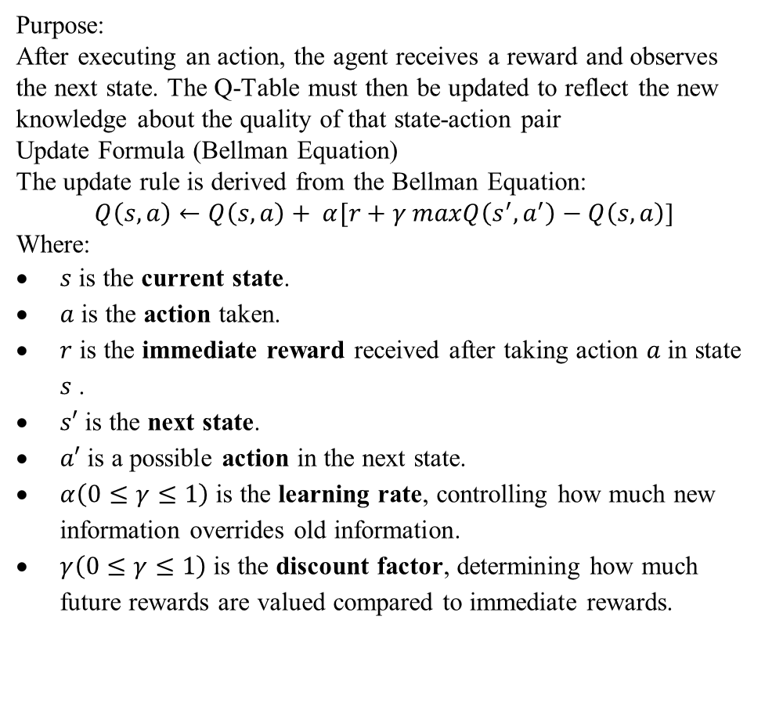
3.5 Action Conversion – Update Q-Table
II. Q-Table Update – The Learning Process
Purpose:
After executing an action, the agent receives a reward and observes the next state. The Q-Table must then be updated to reflect the new knowledge about the quality of that state-action pair
Update Formula (Bellman Equation)
The update rule is derived from the Bellman Equation:
$Q\left(s,a\right)←Q\left(s,a\right)+ α[r+γ maxQ\left(s^{′},a^{′}\right)−Q\left(s,a\right)$]
Where:
$s$ is the current state.
$a$ is the action taken.
$r$ is the immediate reward received after taking action $a$ in state $s$ .
$s′$ is the next state.
$a′$ is a possible action in the next state.
$α\left(0≤γ≤1\right)$ is the learning rate, controlling how much new information overrides old information.
$γ\left(0≤γ≤1\right)$ is the discount factor, determining how much future rewards are valued compared to immediate rewards.
How it works:
Before the Update:
The agent has a Q-value stored in the Q-table for the current state-action pair.
During the Update:
The agent computes the target value:
$r+γ maxQ\left(s^{′},a^{′}\right)$
It then adjusts the current Q-value toward this target using the learning rate 𝛼
After the Update :
The updated Q-value represents a better estimate of the expected cumulative reward if that action is taken in that state.

Slide 44
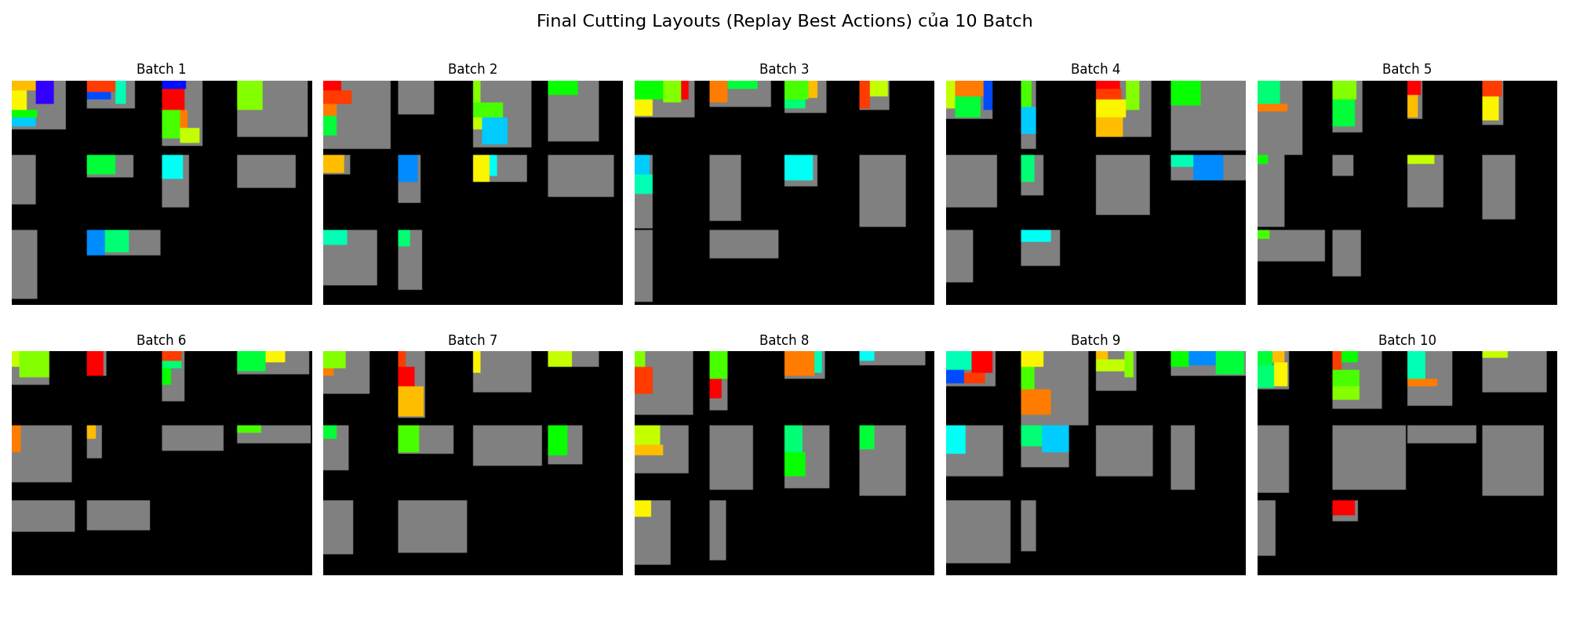
3.6 Result
batch_id | steps | runtime | total_trim_loss | remaining_stock | used_stocks | avg_used_stock_area | total_reward
1 | 35246 | 0 | 3760 | 3 | 7 | 419.7142857 | 4172.708847
2 | 645 | 0 | 6362 | 2 | 8 | 273.875 | 48.72783836
3 | 13112 | 0.007768154 | 1642 | 4 | 6 | 360.3333333 | 1697.795035
4 | 20835 | 0 | 3923 | 3 | 7 | 425.4285714 | 2725.665617
5 | 4637 | 0 | 3999 | 3 | 7 | 218.5714286 | 115.8586754
6 | 6378 | 0 | 2966 | 3 | 7 | 205.1428571 | 481.2505319
7 | 2313 | 0.002004623 | 3389 | 3 | 7 | 228.1428571 | 79.28643512
8 | 6902 | 0.00386095 | 5826 | 2 | 8 | 273.125 | 781.9410143
9 | 9108 | 0.003006458 | 3841 | 4 | 6 | 494.6666667 | 355.5673233
10 | 55 | 0.002004623 | 2823 | 5 | 5 | 312.4 | -4.731796144

Slide 45

3 DEMONSTRATION

Slide 46
III. CONCLUSION

Slide 47
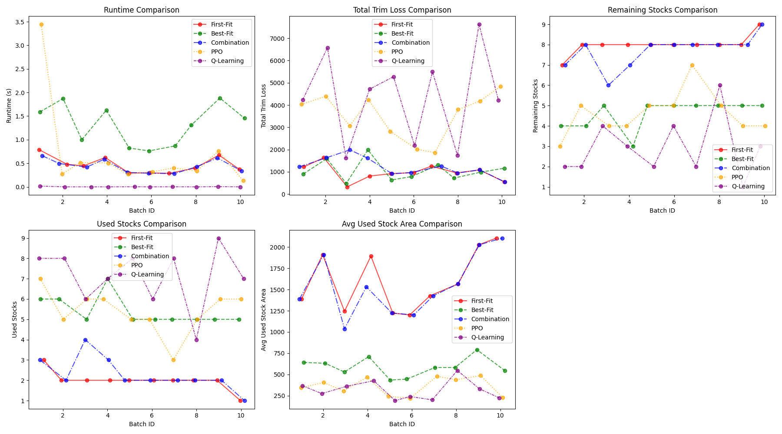

CONCLUSION
Research subject: The 2D cutting stock problem.
Traditional methods: Heuristic algorithms (First Fit, Best Fit) provide quick results and save computational time but often lead to suboptimal material usage.
Reinforcement learning: Techniques like PPO and Q-learning can autonomously learn and improve cutting strategies over time.
Challenges: Long training times and convergence issues.
Potential: Integrating AI in industrial optimization shows promise, offering more effective decision-making support.
Future direction: Refine learning models and adopt hybrid approaches to further enhance performance and scalability.

Slide 48
THANK YOU
FOR WATCHING

